Slide 1
Extracting Data points
Jul 28, 2015

Slide 2
Overview
Objective: Extracting data points and corresponding values contained in the note
Input: Structured pathology note
Algorithm: Regular Expression, Rule-based
Output: Cancer types, data points and values

Slide 3
Algorithm
Search for keyword “Staging summary”
Divide text contained in each note into group(s) based on “Staging summary”
Boundary of each group: from current “Staging summary” to previous line before the next one that contain “Staging summary”
Capture cancer type by collecting previous text before “Staging summary” in that line
If length of previous text is greater than some threshold, ignore this part (Do not make this “Staging summary” as a keyword)

Slide 4

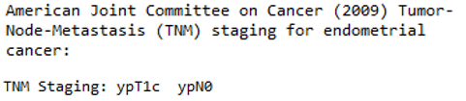
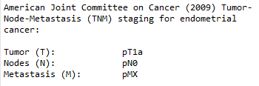
Algorithm
For each group of text, we process line by line
Cut-off the end of text with keyword “tnm(tmn) staging”
If “tnm staging:” is found, cut-off at the end of that line (case 1)
Else, process the next line that is not empty
If “tnm staging:” is found, cut-off at the end of that line (case 2)
Else, process the following lines until the empty line is found (case 3)

Slide 5
Algorithm
Each group of text contains several blocks of information
Block is defined as data point and value (may contain sub-data point)
Divide text into blocks and Process block by block
Step 1: First check whether there is sub-data point by checking for “\t”
Step 2: No sub-data point: simply process by taking data point and its value in one line
With sub-data point: recursively repeat step1 and 2

Slide 6
Result
A multiple layers of dictionaries
Key: note no e.g. 0,1,…,n
Value: a dictionary with a size of (total number of cancer type)+1
Key: Cancer type
ValueType1: a dictionary of data points and their value
Key: data point
Value: a list of value corresponding to its data point and the original text
ValueType2:
Key: “content”
Value: the remaining content in the note that have not been processed

Slide 7
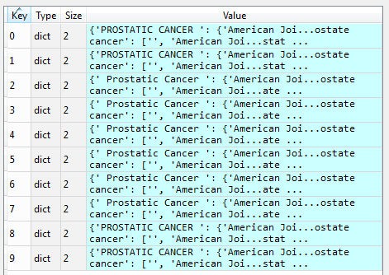
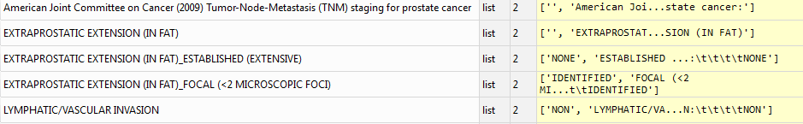

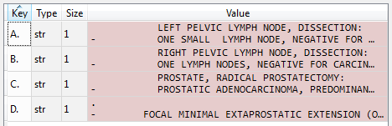

Result

Slide 8
Proposed work
Automatically calculate confident score for each value extracted
Apply to each cancer type and each data point separately
Based on type of text, frequency, length of text,…

